Slide 1
Selenium WebDriver
Creating Scripts using Selenium WebDriver
LEVEL – LEARNER

Slide 2
Mehul Mehta(254777) , T, Senthilvel(260750) and KiranKumar Gourisetty(169305)
Automation Center of Excellence
V1.0, 8/10/2012

Slide 3









Icons Used
Hands on Exercise
Questions
Tools
Coding Standards
Test Your Understanding
Reference
A Welcome Break
Demonstration
Contacts

Slide 4
Objectives
After this Session you will be able to:
Create your own Script in java using Selenium WebDriver
Identify and understand the objects
Understand the WebDriver Method
Working with Buttons,Checkboxes,Drop down and radio button
Handle the window popups
Notes:
Identifying Objects
Understanding the Locators
Know about Web Driver Method
Working with Textboxes, Checkboxes
Working With Links
Working With Drop Downs
Working With Assertions and Verifications
Moving Between Windows & Frames
Pop-up's Dialog
Upload & Download – Handle the Windows Popups

Slide 5
Tools Needed
Tools needed to work on Selenium Web Driver
Eclipse
Selenium JAR
Internet Explorer – IE developer Tool
Fire Fox – Firebug , Fire Path

Slide 6
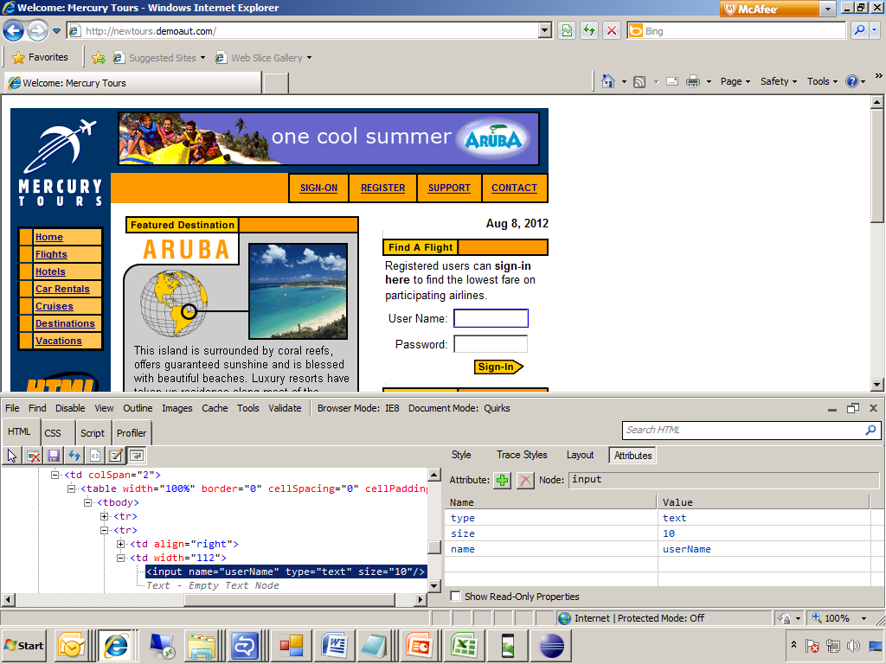
Identifying Objects
Selenium Web Driver works using “Elements/Objects” by extracting them from the “View Source Page” of all browsers. Browsers have inbuilt Tool/Addons for identifying the properties of each element as listed below,
Using Developer Tool Bar In Internet Explorer
Internet Explorer has developer tool bar it is used to spy the element and to get the properties of the element.
Open IE → Tools → Developer Tool or press F12 to open it directly.

Slide 7
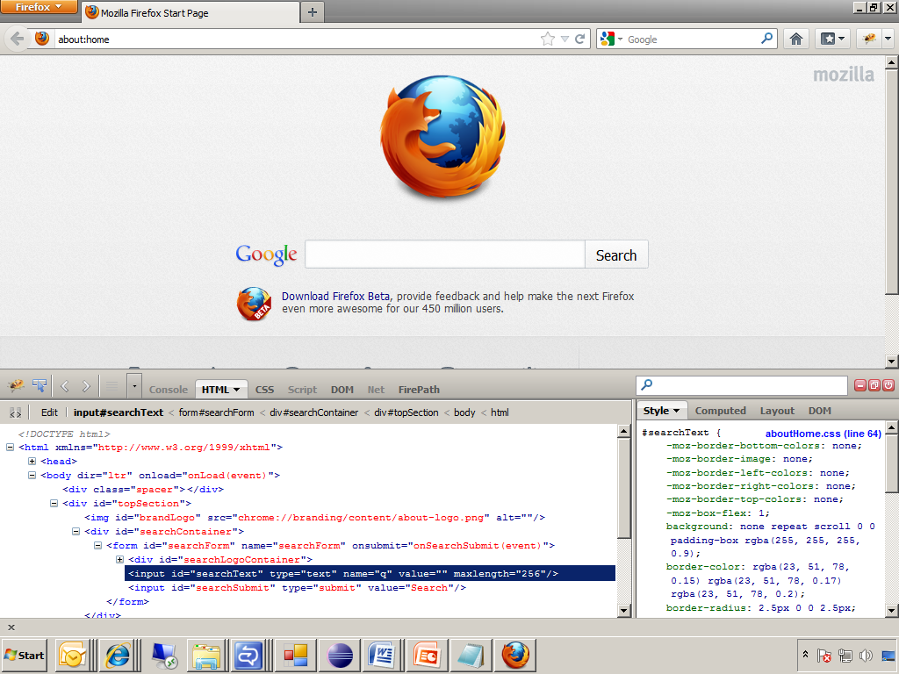
Identifying Objects
Using Fire Bug Add-on In Firefox
In Firefox fire bug is the best add-on to spy the object.
Firefox → web developer → Fire bug .To install the fire bug Go to add-ons → search for Fire bug → install it

Slide 8
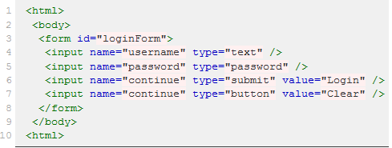
Understanding the Locators
For many WebDriver methods, a target is required. Target identifies the element in the content of the web application, and consists of locator.
A locator can be an element id, an element name, an xpath expression, an Hyperlinks by link text, an Dom and CSS .
WebDriver uses any of those as target. The various locator types are explained below with examples for each.
For instance, all these are found in Page Source.

Slide 9
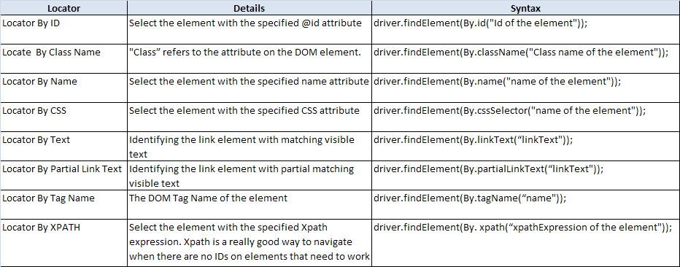
Understanding the Locators

Slide 10
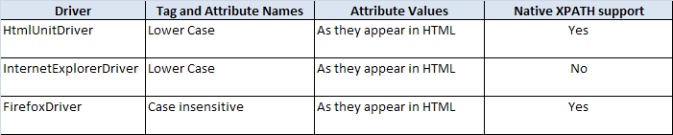
Understanding the Locators
At a high level, WebDriver uses a browser’s native XPath capabilities wherever possible. On those browsers that don’t have native XPath support, selenium has its own implementation. This can lead to some unexpected behavior unless you are aware of the differences in the various xpath engines.
This is a little abstract, so for the following piece of HTML:
<input type="text" name="example" /> <INPUT type="text" name="other" />

Slide 11
Understanding the Locators
Matching Implicit Attributes
Sometimes HTML do not need attributes to be explicitly declared because they will default to known values. For example, the "input" tag does not require the "type" attribute because it defaults to "text". The rule of thumb when using xpath in WebDriver is that you should not expect to be able to match against these implicit attributes.
Locator By XPATH :-
Select the element with the specified Xpath expression. Xpath is a really good way to navigate when there are no IDs on elements that need to work with or is near the element want to work with.
Syntax
driver.findElement(By. xpath(“xpathExpression of the element"));

Slide 12
Understanding the Locators
Locating Techniques of Useful XPATH patterns
starts-with `
Many sites use dynamic values for element’s id attributes, which can make them difficult to locate. One simple solution is to use XPath functions and base the location on what you do know about the element. For example, if your dynamic ids have the format <input id="text-12345" /> where 12345 is a dynamic number you could use the following XPath://input[starts-with(@id, 'text-')]
contains
If an element can be located by a value that could be surrounded by other text, the contains function can be used. To demonstrate, the element <span class="top heading bold"> can be located based on the ‘heading’ class without having to couple it with the ‘top’ and ‘bold’ classes using the following XPath: //span[contains(@class, 'heading')].
Incidentally, this would be much neater (and probably faster) using the CSS locator strategy css=span.heading.

Slide 13
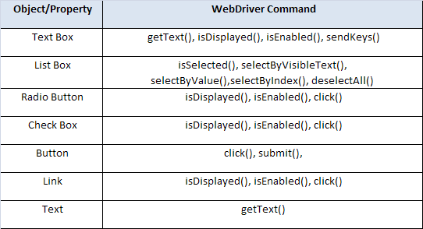
WebDriver Methods

Slide 14
Working with Textboxes, Checkboxes
Click Method – To click objects like Buttons, links and to check and uncheck checkboxes and select Radio Button
driver.findElement(By.name(“locator")).click();
Type Value in Text Box
driver.findElement(By.name(" locator ")).sendKeys(“Test Data");
Keyboard Simulations & Type value in Text box- Keyboard simulations can be done using “KEYS” class
driver.findElement(By.name(" locator ")).sendKeys(Keys.ENTER));
Get Text/Value from a page/objects
driver.findElement(By.name(“locator")).getText();
Since it is a property it can be stored in the string and verification can be done.
e.g. String GetTextContent = driver.findElement(By.name(“locator")).getText();

Slide 15
Working with Textboxes/Links
Erasing existing text and entering new Text in text box – Erase value/text already exists in a text box and enter new value/text.
driver.findElement(By.name(“locator")).clear();
Get Text/Value from using getAttribute method- Another way to get the value of the given attribute of Element. Returns current value
driver.findElement(By.name(“locator")).getAttribute();
Accessing the links - using Click Method- Links can be identified by using
Link Text
driver.findElement(By.linkText(“locator")).click();
Partial Link Text
driver.findElement(By.partialLinkText(“locator")).click();
Notes:
Get Text/Value from using getAttribute method- This is an other way to get the value of a the given attribute of Element.
It will return the current value, even if this has been modified after the page
has been loaded.
More exactly, this method will return the value of the given
attribute, unless that attribute is not present, in which case the value of the property
with the same name is returned. If neither value is set, null is returned. The "style"
attribute is converted as best can be to a text representation with a trailing semi-
colon.

Slide 16
Working With Drop Downs
In Selenium Web Driver drop downs are handled in separate Select Class
Select select = new Select(driver.findElement(By. Name("select")));
select.selectByVisibleText(“Text");
Other Select methods
selectByVisibleText() - This will select by visible text from the application
selectByValue() - Values can also be selected from the application
selectByIndex() - Values can also be selected using index value.
Similarly selected values can also be deselected using following methods,
deselectAll()-This will deselect all values which is selected from the application
deselectByVisibleText()-This will deselect by visible text from the application
deselectByValue()-Values can also be deselect by value from the application
deselectByIndex()-Values can also be deselected using index value
To get all selected options getAllSelectedOptions() is used
List<WebElement> selected = select.getAllSelectedOptions();

Slide 17
Demonstration

Slide 18
Working With Assertions and Verifications
Assertion
assertion is to indicate whether particular statement returning true or false.
If an assertion evaluates to false an assertion failure results, which typically causes execution to abort. Below are the list of Selenium Web Driver methods used for validation
AssertTrue(driver.findElement(By.name(" locator ")).isDisplayed());
Exp : This method is used to verify whether the element is displayed in the page or not
AssertTrue(driver.findElement(By.name(“locator")).isEnabled());
Exp : Verifies whether any object(Text Box, Check Box, Radio Button & List box) are enabled
AssertTrue(driver.findElement(By.name(" locator ")).isSelected());
Exp : Verifies any value is selected in list box or not

Slide 19
Moving Between Windows
In some web application multiple browser window may get opened (or a new tab) after doing some action (click a link for example) . In that If we have to perform some scenario like clicking some buttons and getting some text or validation on the newly opened page below code is used for that
driver.switchTo().window("windowName");
Window Name can be taken by two ways.
From page source
Using the getWindowHandles()) method
Set<String> set = driver.getWindowHandles();
while (set.size() != 2) {
Thread.sleep(2000);
set = driver.getWindowHandles(); }
System.out.println("Window Handle: "+ set.toArray()[1].toString());
driver = driver.switchTo().window(set.toArray()[1].toString());
To return back the focus to the default window
driver = driver.switchTo().window(set.toArray()[0].toString());

Slide 20
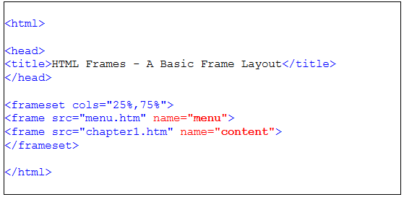
Moving Between Frames
In Some application object will be inside a frame. For reading those objects inside a frame below is the syntax. Frame names can be identified In page source of the application. Frame names can be directly passed in to the code
driver.switchTo(). frame("frame Name");

Slide 21
Pop-up Dialog
In Selenium Web driver there is a built in support for handling the popup dialog boxes. Any pop-up which is triggered from the application can he handled by “Alert”
Alert alert = driver.switchTo().alert();
This will return the currently open alert object. With this object you can now accept, dismiss, read its contents or even type into a prompt. This interface works equally well on alerts, confirms, and prompts.
Handle the Upload Popup:
public void testMethod() throws Exception {
driver.get(“http://URL");
alert upload = driver.switchTo().alert();
upload.sendKeys("/Users/sso/the/local/path/to/file.jpg");
driver.findElement(By.id("submit")).click();
driver.findElement(By.tagName("img"));

Slide 22
Upload & Download – Handle the Windows Popups
In general if download and upload dialogs are not with browser and if it with windows prompts. This can't be handle using
driver.switchTo().window("Window Name"); or
driver.switchTo().alert();
So the options available to handle the windows popup are
1.Using Auto IT tool script 2. Using AWT robot and JInvoke
Using Auto IT Tool(Method 1)
Auto It is a freeware windows testing tool. Auto It allow to access windows components.
Basically once the id of the component is identified on the screen and it can be used by either clicking on it, typing in something, closing, accessing menu, etc.
Using Auto IT we can identify the internet explorer “Choose file” or firefox “File Upload” windows and enter the correct value to the input field after which you will press the open button

Slide 23
Upload & Download – Handle the Windows Popups
How to add Auto IT to our project
Auto IT Jar can be download from http://code.google.com/p/autoitx4java/ and it can add in the project then the script can be created.
Below is the code Auto IT script for File Download.
WinWait("File Download"); WinActivate("File Download"); ControlClick("File Download", "","[CLASS:Button; INSTANCE:2]"); WinWait("Save As"); WinActivate("Save As"); ControlSetText("Save As", "", "[CLASS:Edit; INSTANCE:1]", "c:\Report.pdf") ControlClick("Save As", "","[CLASS:Button; INSTANCE:2]"); WinWait("Download complete"); WinActivate("Download complete"); ControlClick("Download complete", "","[CLASS:Button; INSTANCE:4]");

Slide 24
Upload & Download – Handle the Windows Popups
Using AWT Robot & JInvoke (Method 2)
AWT Robot infrastructure is part of standard Java release and allows (between many others features), control over keyboard.
Basically what you need to emulate is typing the name of the file that you need to upload and then pressing the enter key.
In some cases this will work and in some cases the focus is somehow not on the dialog but on some other open window. This is a known problem with the AWT Robot when coming to non Java windows.
To handle it, we need to add the ability to focus correctly on the window and data is typed in. This can be done using third party tool - Jinvoke

Slide 25
Upload & Download – Handle the Windows Popups
JInvoke is a commercial package allowing native calls from Java code.
import com.jinvoke.win32.User32;
public void makeWindowActive(String windowName, int timeToWait) throws Exception { Thread.sleep(timeToWait); int winPtr = User32.FindWindow(null, windowName); if ( winPtr != 0){ User32.SetForegroundWindow(winPtr); } else { throw new Exception("Unable to find the " + windowName + " window!!"); } }
After focusing on the objects below is the AWT robot code to handle the popup
Robot robot = new Robot(); robot.delay(3000); robot.keyPress(KeyEvent.VK_xxx);

Slide 26
Demonstration

Slide 27
Questions

Slide 28
Break

Slide 29
Test Your Understanding
What is code for clicking the Radio button?
What is xpath?
How to select a value from the Dropdown box?
What is alert?

Slide 30
Summary
Creating your own Script in java using Selenium WebDriver
Identifying and understanding the objects
Understanding the WebDriver Method
Working with Buttons, Checkboxes, Drop down and radio button
Handling the window popups

Slide 31
Source
http://seleniumhq.org/
http://code.google.com/p/selenium
Disclaimer: Parts of the content of this course is based on the materials available from the Web sites and books listed above. The materials that can be accessed from linked sites are not maintained by Cognizant Academy and we are not responsible for the contents thereof. All trademarks, service marks, and trade names in this course are the marks of the respective owner(s).

Slide 32
Selenium WebDriver
You have successfully completed -Creating Scripts using Selenium WebDriver

